Slide 1


Stilzitten & Bewegen
Preventie van kanker
Prof dr J (Hans) Zwerver, sportarts
Bijzonder hoogleraar Sport- en Beweeggeneeskunde

Slide 2









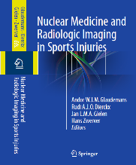

Disclosure
(Potential) conflict of interest
Grants Financial support for research projects Profits

Slide 3




Slide 4
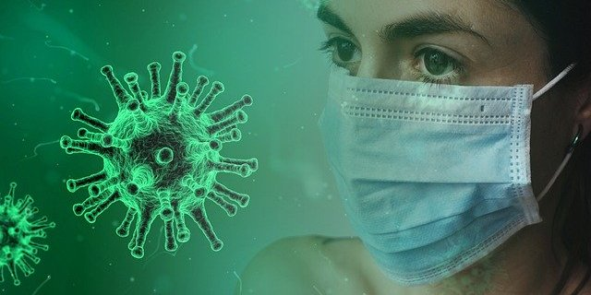

Pandemie

Slide 5
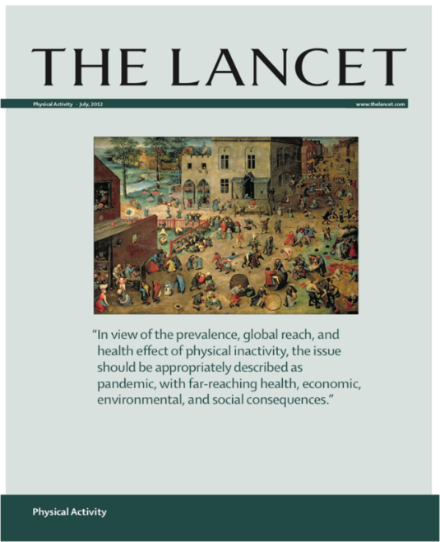
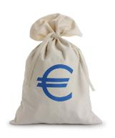
Pandemie
2012!

Slide 6
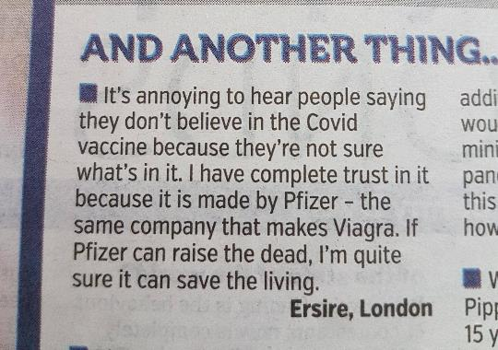
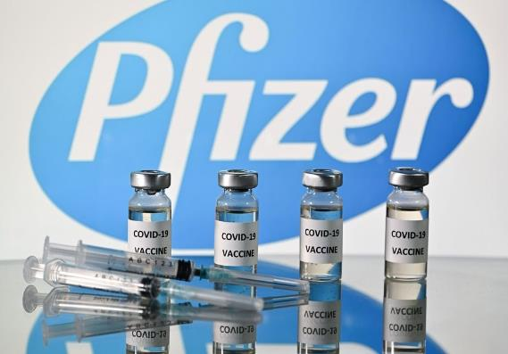
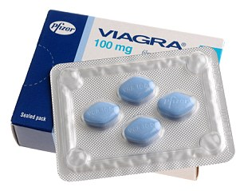
Vaccin
Notes:
Sex and drugs
Since 1998, the world’s favourite little blue
pill, Viagra, has revolutionised treatment
for erectile dysfunction. At the time of
its approval, Viagra had the fastest initial
sales growth following its launch of any
prescription product. The pharmaceutical
company promoted Viagra and erectile
dysfunction awareness via direct-to-consumer
advertising which is permitted in
many countries. They bypassed the traditional
channel of having doctors as the
catalyst to start the medication.

Slide 7
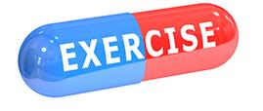
The (s)exercise pill

Slide 8
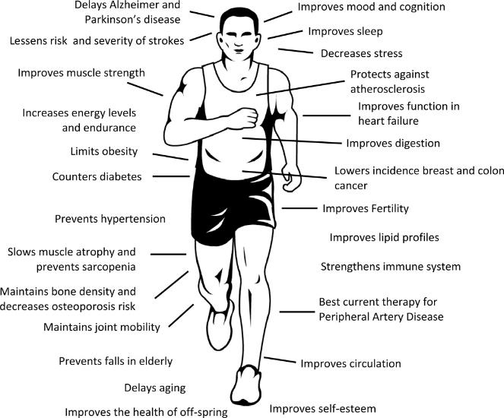



Long term benefits of exercise
xxx
Rowe GC, Safdar A, Arany Z. Running forward: new frontiers in endurance exercise biology. Circulation. 2014;129(7):798-810.

Slide 9
Cardiorespiratory Fitness - VO2max
Low levels of cardiorespiratory fitness (CRF) are associated with a high risk of cardiovascular disease, all-cause mortality, and mortality rates attributable to various cancers.
‘Cardiorespiratory Fitness is the only major risk factor for cardiovascular disease and mortality that is not assessed in clinical practice’
’The addition of CRF for risk classification presents health professionals with unique opportunities to improve patient management and to encourage lifestyle-based strategies designed to reduce cardiovascular risk.’
Increase 3,5 ml O2/kg =
14-20 % survival benefit
Ross et al. Circulation. 2016;134:e653–e699

Slide 10
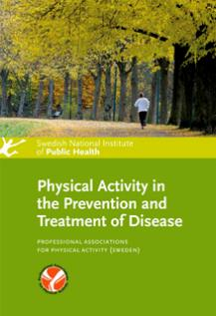

Bewegen bij chronische aandoeningen
Kanker
Psychiatrische en neurologische aandoeningen
Metabole aandoeningen
Hart-vaatziekten
Longaandoeningen
Musculoskeletale aandoeningen
Bewegen bewezen effectief!

Slide 11
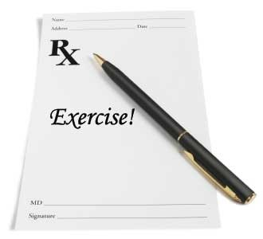
Beweegrecept

Slide 12
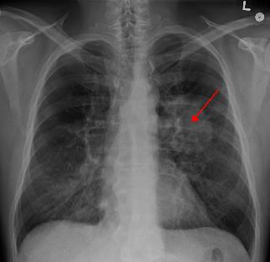
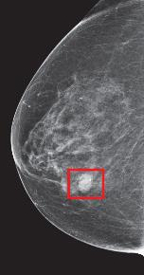
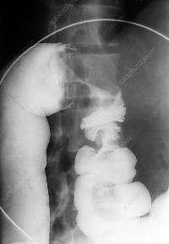
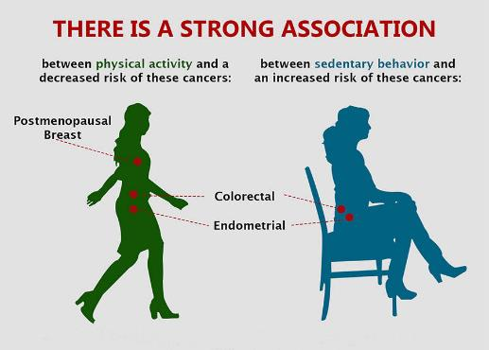

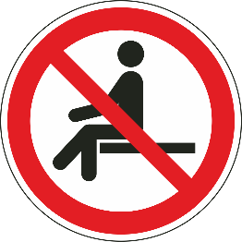
Kanker

Slide 13
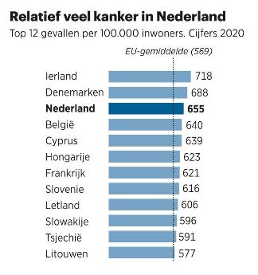
Kanker in Nederland
www.wkof.nl/nl/kanker
Notes:
Betere registratie en screening
Emancipatie vrouwen longkanker
Lichtere huid melanomen

Slide 14
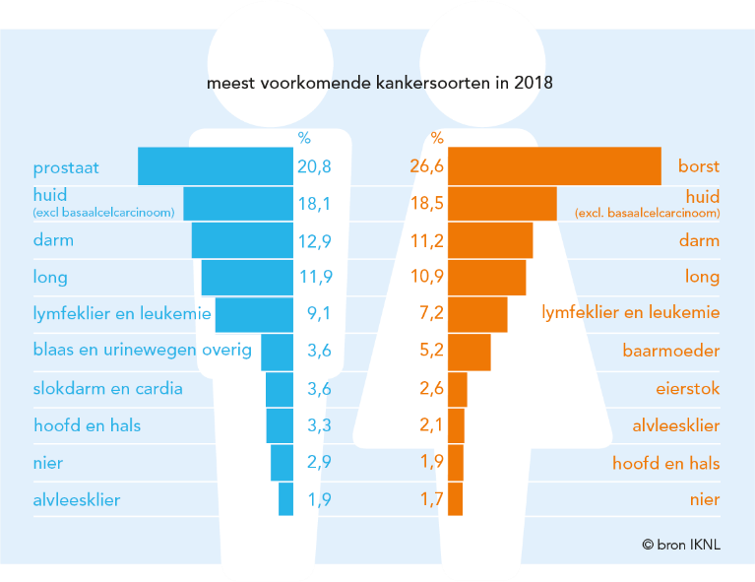
Kanker: welke soort?
Notes:
Huidkanker flink toegenomen, meer aandacht
30 jaar geleden exposure

Slide 15
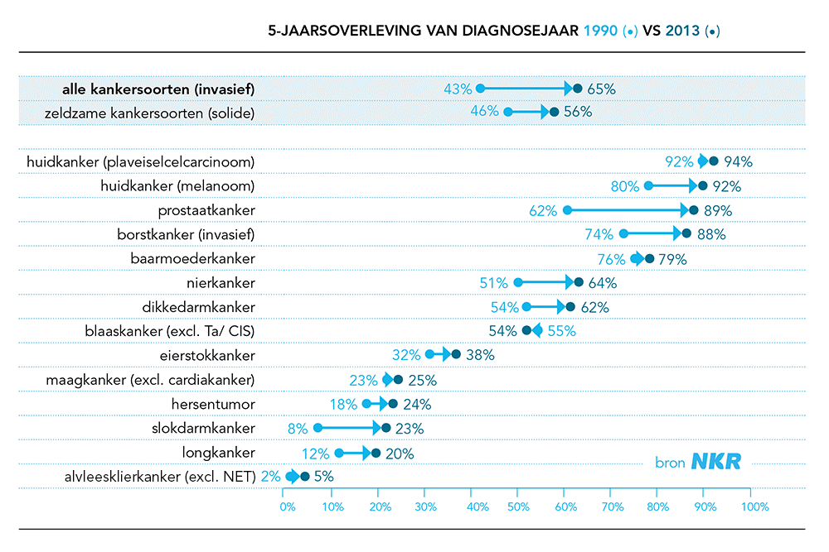
Kanker: 5- jaarsoverleving 65%
Neemt per jaar met 1% toe !
Ca. 600.000 overlevers!
  Vermoeidheid
  Angst – depressie
  Fysiek functioneren
  Quality of life
Notes:
Betere registratie en screening
Emancipatie vrouwen longkanker
Lichtere huid melanomen

Slide 16
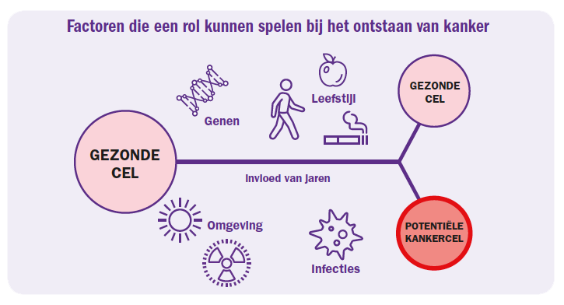
Kanker
Notes:
Betere registratie en screening
Emancipatie vrouwen longkanker
Lichtere huid melanomen

Slide 17
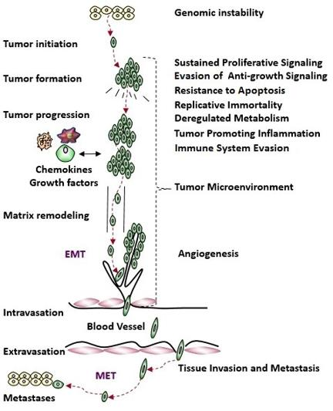
Kanker: complexe pathofysiologie
From: Block KI, Gyllenhaal C, Lowe L, et al. Designing a broad-spectrum integrative approach for cancer prevention and treatment. Semin Cancer Biol 2015; 35 Suppl: S276-s304. Licenced under CC BY 4.0.
Notes:
From: Block KI, Gyllenhaal C, Lowe L, et al. Designing a broad-spectrum integrative approach for cancer prevention and treatment. Semin Cancer Biol 2015; 35 Suppl: S276-s304. Licenced under CC BY 4.0.
The hallmarks of cancer represented on the right are functional abnormalities characteristic of cancer cells, which can be related to the pathophysiological stages of cancer development, represented on the left.

Slide 18
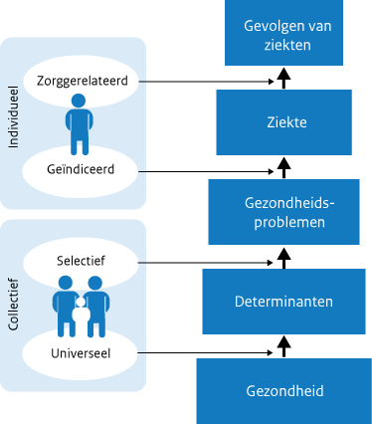
Preventie

Slide 19
40% kanker te voorkomen door gezondere leefstijl!
Notes:
How to cite the 2018 Third Expert Report:
World Cancer Research Fund/American Institute for Cancer Research. Diet, Nutrition, Physical Activity and Cancer: a Global Perspective. Continuous Update Project Expert Report 2018. Available at dietandcancerreport.org
How to cite this part of the Third Expert Report:
World Cancer Research Fund/American Institute for Cancer Research. Continuous Update Project Expert Report 2018. Diet, nutrition, physical activity and bladder cancer. Available at dietandcancerreport.org
To inquire about permission for any other use contact copyright@wcrf.org

Slide 20
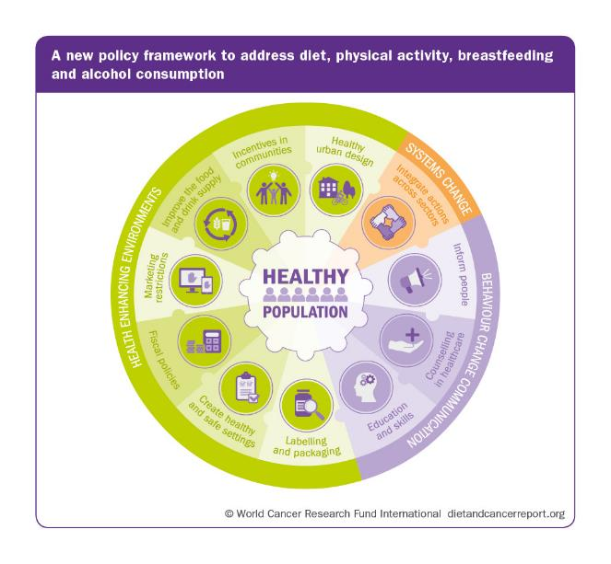
Notes:
A new policy framework that can be used to identify a comprehensive package of actions needed to create environments for people and communities that are conducive to following the Cancer Prevention Recommendations.

Slide 21
Notes:
While following each individual Recommendation offers cancer protection benefit, most benefit is gained by treating all ten Recommendations as an integrated pattern of behaviours relating to diet, physical activity and other factors that can be considered as a single overarching ‘package’ or way of life.

Slide 22

Staying alive!

Slide 23

Preventie kanker en bewegen
MSSE 2019

Slide 24
Systematic review
Overzicht van bewijs voor de associatie tussen fysieke activiteit en
  Risico op kanker
  Mortaliteit bij personen met kanker
    Dose – response relationship
Conform PRISMA guidelines
Systematic reviews, meta-analysis, pooled analysis (n = 48)
Quality assessment / Grading of Evidence

Slide 25
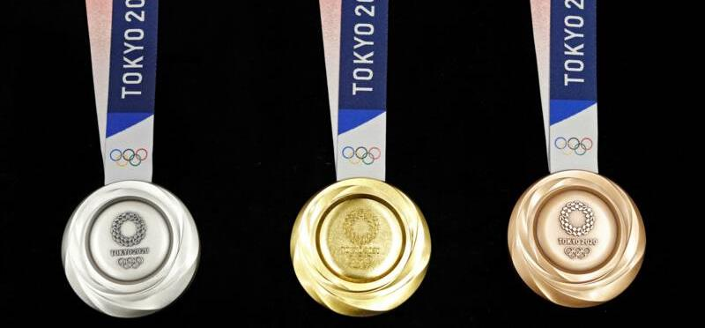
Bewijskracht
Redelijk Sterk Beperkt

Slide 26
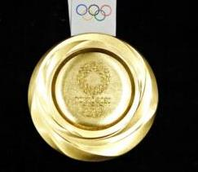
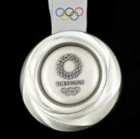
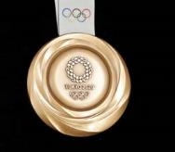
Bewegen is effectief voor preventie kanker!

Slide 27
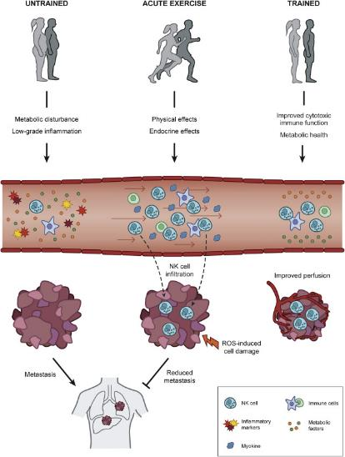
Werkingsmechanisme
Hojman et al. Cell metabolism Volume 27, Issue 1, 9 January 2018, Pages 10-21
Notes:
Molecular Mechanisms Linking Exercise to Cancer Protection
Exercise consists of: (1) Acute sessions leading to physical (increased blood flow, shear stress on the vascular bed, temperature increases, sympathetic activation) and endocrine (release of catecholamines and exercise hormones, myokine secretion) regulation that results in increased tumor perfusion, oxygen delivery, intratumoral metabolic stress, cellular damage, and ROS production. These acute changes are able to elicit signaling pathways that prevent metastasis. (2) Chronic training adaptations comprising systemic alterations with improved immune function, reduced systemic inflammation, and improved metabolic health, as well as intratumoral changes in the form of enhanced blood perfusion, immunogenic profile, and immune cell infiltration.

Slide 28
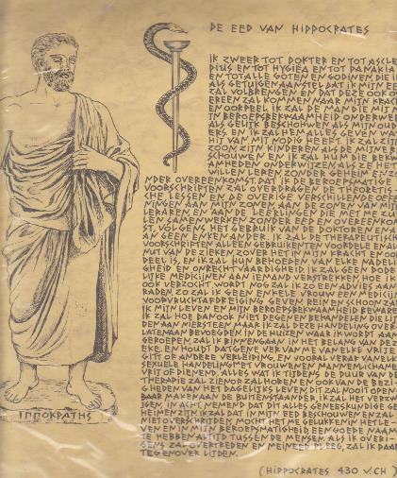
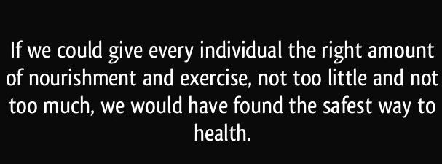
Hoeveel en wat voor beweging?
Iedere stap telt!
Verder onderzoek nodig
Aeroob / Anaeroob
Kracht
Combi

Slide 29
Advies - Beweegrichtlijnen 2017!

Slide 30
Bewegen geeft ook betere survival!

Slide 31
Kanker en bewegen
MSSE 2019

Slide 32
Consensus statement
Exercise training and testing safe for cancer survivors and that every survivor should “avoid inactivity.”
Enough evidence that specific doses of training could improve common cancer-related health outcomes
Implications for other outcomes, such as peripheral neuropathy and cognitive functioning, remain uncertain.
The proposed recommendations are guide for the fitness and health care professional working with cancer survivors.
More research is needed to fill remaining gaps in knowledge to better serve cancer survivors, as well as fitness and health care professionals, to improve clinical practice.

Slide 33
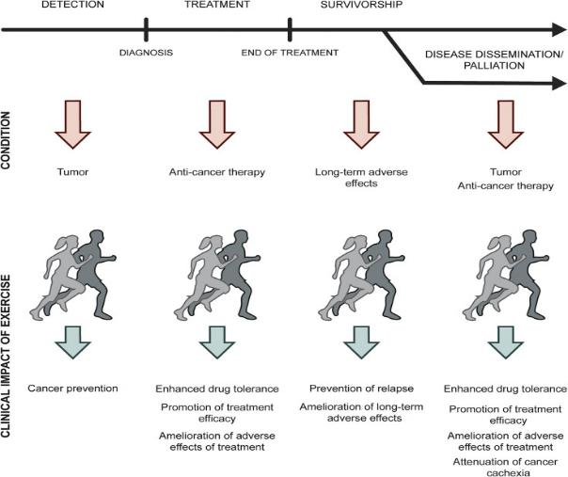
Kanker en bewegen

Slide 34
Relevante literatuur

Slide 35
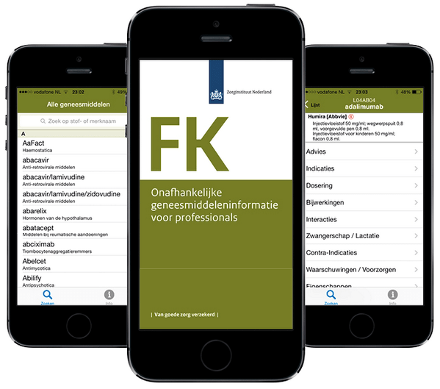
Farmacotherapeutisch kompas
Bewegen???

Slide 36
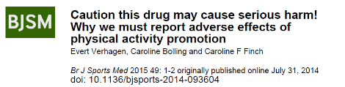
Bijwerkingen
Blessures!!
  Spier Pees
  Bot
  Kraakbeen Gewricht
Zeldzaam: plotse hartdood

Slide 37

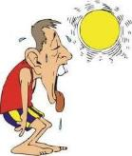
Waarschuwingen / Voorzorgen
Start low, go slow!
Tenminste uur na de maaltijd gebruiken!
Combineren met gezonde voeding, voldoende vocht en slaap
Niet in combinatie met sigaretten gebruiken
Pas op bij gebruik in de zon / hitte!
Verslavend!
Bij contra-indicaties & risicofactoren:
Preventief (sport)medisch onderzoek en individueel beweegadvies

Slide 38
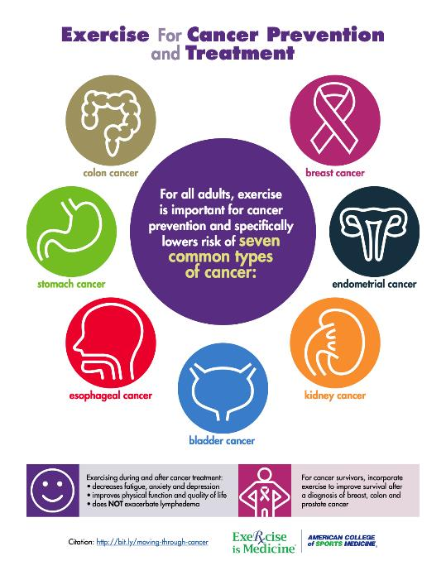

Bewegen en Kanker
Effectief in preventie!
Betere survival!
  Minder vermoeidheid
  Minder angst en depressie
  Verbetering fysiek functioneren
  Verbetering Kwaliteit van Leven

Slide 39
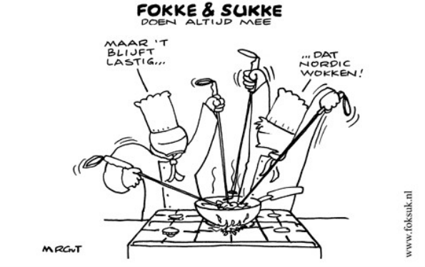
Best lastig……maar breng mensen in beweging!

Slide 40
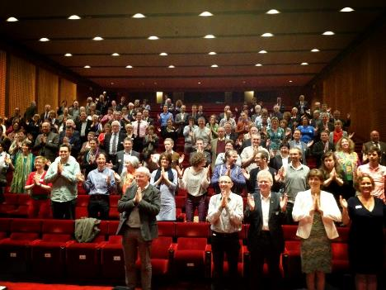
Dankuwel!
Aandacht!
Actieve participatie!
(Staande?) ovatie!
jzwerver@zgv.nl

